Slide 1
Functions in C
Group Members
Kartik Jadhav
Sanskar Kabra
Parva Joshi
Siddhesh Patil

Slide 2
WHAT are FUNCTIONS ?
A function is a block of code which only runs when it is called.
You can pass data, known as parameters, into a function.
Functions are used to perform certain actions, and they are important for reusing code: Define the code once, and use it many times.

Slide 3
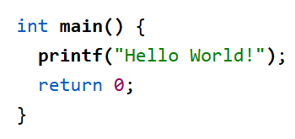
PREDEFINED FUNCTIONS
So it turns out you already know what a function is. You have been using it the whole time
For example, main() is a function, which is used to execute code, and printf() is a function; used to output/print text to the screen

Slide 4
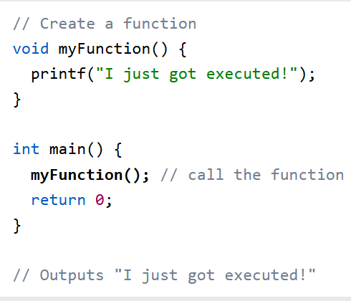
CREATE a FUNCTION
To create your own function, specify the name of the function, followed by parentheses () and curly brackets {}
CALL a FUNCTION
Declared functions are not executed immediately. They are "saved for later use", and will be executed when they are called.
To call a function, write the function's name followed by two parentheses () and a semicolon ;

Slide 5
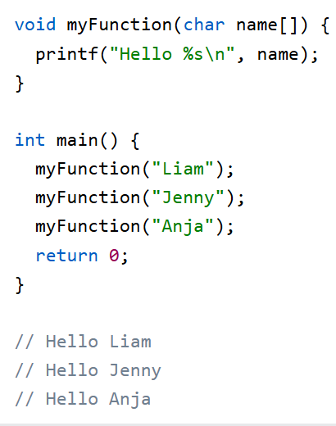
Parameters and Arguments
Information can be passed to functions as a parameter. Parameters act as variables inside the function.
Parameters are specified after the function name, inside the parentheses. You can add as many parameters as you want, just separate them with a comma

Slide 6
Pass by Value
In pass by value, a copy of the actual argument is passed to the function. Changes made inside the function do NOT affect the original variable.
How it works:
A new memory location is created for the parameter.
The function works only on the copied value.
When to USE
Use Pass by Value when you don’t want the original data changed

Slide 7
Pass by Reference
In pass by reference, the address of the variable is passed to the function using pointers. Changes made inside the function DO affect the original variable
How it works:
The function receives the variable’s address.
It directly modifies the original memory location
When to USE
Use Pass by Reference when you need to modify original variables or return multiple values

Slide 8
Key Differences
FEATURE | Pass by Value | Pass by Reference
What is passed | Copy of value | Address of variable
Original variable affected | NO | YES
Memory used | Extra memory for copy | Same memory location
Uses pointers | NO | YES

Slide 9
SCOPE
Now that you understand how functions work, it is important to learn how variables act inside and outside of functions.
In C, variables are only accessible inside the region they are created. This is called scope.
LOCAL SCOPE
A variable created inside a function belongs to the local scope of that function, and can only be used inside that function
GLOBAL SCOPE
A variable created outside of a function, is called a global variable and belongs to the global scope.
Global variables are available from within any scope, global and local

Slide 10
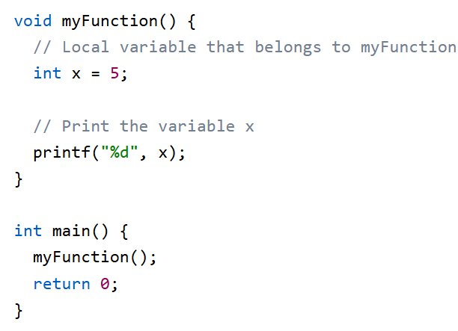
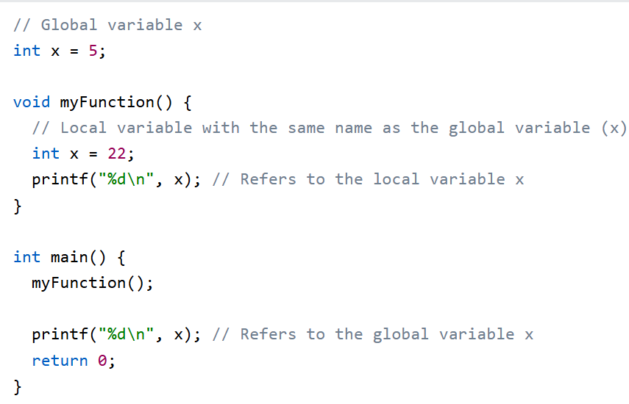
EXAMPLES OF SCOPE
Local Scope
Global Scope

Slide 11
WHY USE FUNCTIONS
Avoids repetition (Reusability)
Instead of writing the same code multiple times, you write it once in a function and call it whenever needed.
Makes programs easier to understand
Breaking a big program into small functions makes it neat and readable.
Saves time and effort
Once a function is written and tested, you can reuse it in same program or different
Easy debugging and testing
If something goes wrong, you only check that function, not the whole program.

Slide 12
TYPES OF USER-DEFINED FUNCTIONS
No arguments, no return value
Arguments, no return value
No arguments, return value
Arguments and return value

Slide 13
REAL WORLD USES OF FUNCTIONS
Banking Systems Functions handle account creation, deposits, withdrawals, and balance checks
Operating Systems Used for file handling, memory management, and process control
Embedded Systems Functions control hardware like sensors, motors, and displays
Gaming Applications Separate functions manage graphics, sound, player movement, and scoring
Medical Equipment Software Functions process sensor data and monitor patient health
Telecommunication Systems Used for call handling, signal processing, and data transmission
E-commerce & Billing Software Functions calculate prices, taxes, discounts, and generate invoices

Slide 14
CONCLUSION
Functions are essential in c programming
They improve efficiency and clarity
Encourage structured and modular coding

Slide 15
Thank You

